Slide 1

EMPLOYEES BURNOUT ANALYSIS
PRESENTED BY:
SARVASUDDI AJAY KUMAR
sajayvijay987@gmail.com
Under Reacha Foundation
Kakinada Institute Of Engineering & Technology
Andhra Pradesh

Slide 2
PROJECT Title: Employee Burnout Analysis and Prediction
Project Statement:
Employee burnout is a significant issue affecting productivity, employee well-being, and overall organizational health. This project aims to analyze the factors contributing to employee burnout and develop predictive models to identify at-risk employees. By leveraging data analytics and machine learning techniques, the project seeks to provide actionable insights and preventive strategies to mitigate burnout and enhance workplace well-being.

Slide 3
AGENDA
Project Overview
Introduction to the project and its objectives.
Who Are the End Users
Identification of stakeholders and beneficiaries of the project.
Solution and Its Value Proposition
Detailed description of the solution and the benefits it provides.
How Did You Customize the Project and Make It Your Own
Explanation of the unique elements and customizations implemented in the project.
Modeling
Overview of the data modeling process, techniques, and algorithms used.
Results
Presentation of the key findings, predictions, and actionable insights derived from the project.

Slide 4
PROJECT OVERVIEW
Objective: To analyze and predict employee burnout using a dataset from Kaggle.
Dataset Details:
Source: Kaggle
Features: Employee ID, Date of Joining, Gender, Company Type, WFH Setup Available, Resource Allocation, Mental Fatigue, Burn Rate
Methodology: Linear Regression Model
Tools Used: Python, Pandas, Scikit-Learn, Matplotlib
Visuals:
Dataset preview table
Flowchart of the analysis process (data collection, preprocessing, modeling, evaluation)

Slide 5
WHO ARE THE END USERS of this project?
Target Auidence:
HR Departments: For monitoring employee well-being and taking preventive measures
Management: For strategic decision-making to improve work conditions
Employees: To self-assess and seek help when needed.
Benefits for End Users:
HR Departments: Early detection of burnout to reduce turnover rates.
Management: Improved productivity and employee satisfaction.
Employees: Better awareness and resources for managing stress.

Slide 6
YOUR SOLUTION AND ITS VALUE PROPOSITION
Solution Overview:
Predictive Model: Uses linear regression to forecast employee burnout.
Dashboard: User-friendly interface showing key metrics.
Custom Reports: Tailored insights for HR, management, and employees.
Value Proposition:
Proactive Intervention: Identifies burnout early for timely action.
Enhanced Well-Being: Improves employee satisfaction and reduces turnover.
Informed Decisions: Provides data-driven insights for strategic planning.
Cost Savings: Lowers costs related to turnover and absenteeism.
Competitive Edge: Maintains a motivated and efficient workforce.

Slide 7
How did you customize the project and make it your own
Project Customization: Decision Tree Utilization and Exploratory Analysis
1. Decision Tree Implementation
Model Choice: Opted for Decision Tree regression due to its ability to handle non-linear relationships and provide transparent insights into feature importance.
Customization: Fine-tuned hyperparameters and visualized tree structures to decipher critical factors influencing employee burnout rates.
2. Exploratory Data Analysis (EDA)
Correlation Matrix: Utilized to initially assess relationships between variables such as workload, mental fatigue scores, and burnout rates. Visualized using a heatmap.
Pairplot: Employed for in-depth exploration of variable distributions and pairwise interactions, providing insights into data characteristics and potential patterns.

Slide 8
MODELLING
1. Model Selection
Decision Tree Regression: Chosen for its interpretability and ability to capture non-linear relationships in predicting employee burnout rates.
2. Model Building
Data Preprocessing: Standardized numerical features using StandardScaler for uniform scale across variables.
Training: Utilized DecisionTreeRegressor to train the model on a 70-30 split of training and testing data.
3. Evaluation Metrics
Mean Squared Error (MSE), Root Mean Squared Error (RMSE), Mean Absolute Error (MAE): Used to assess prediction accuracy.
R-squared Score (R2): Evaluated model fit and explained variance in burnout rates.

Slide 9
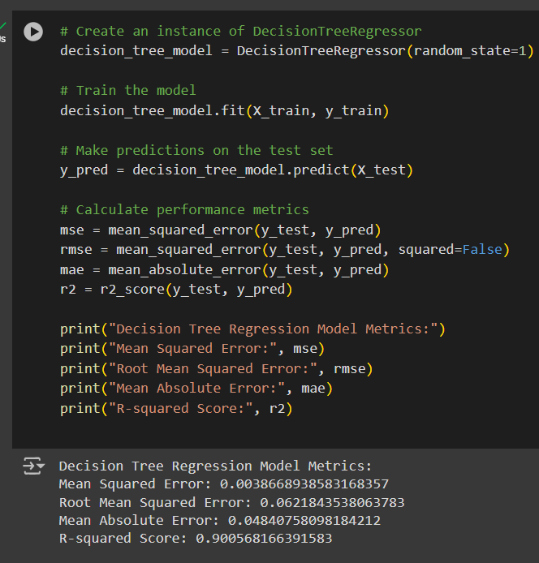
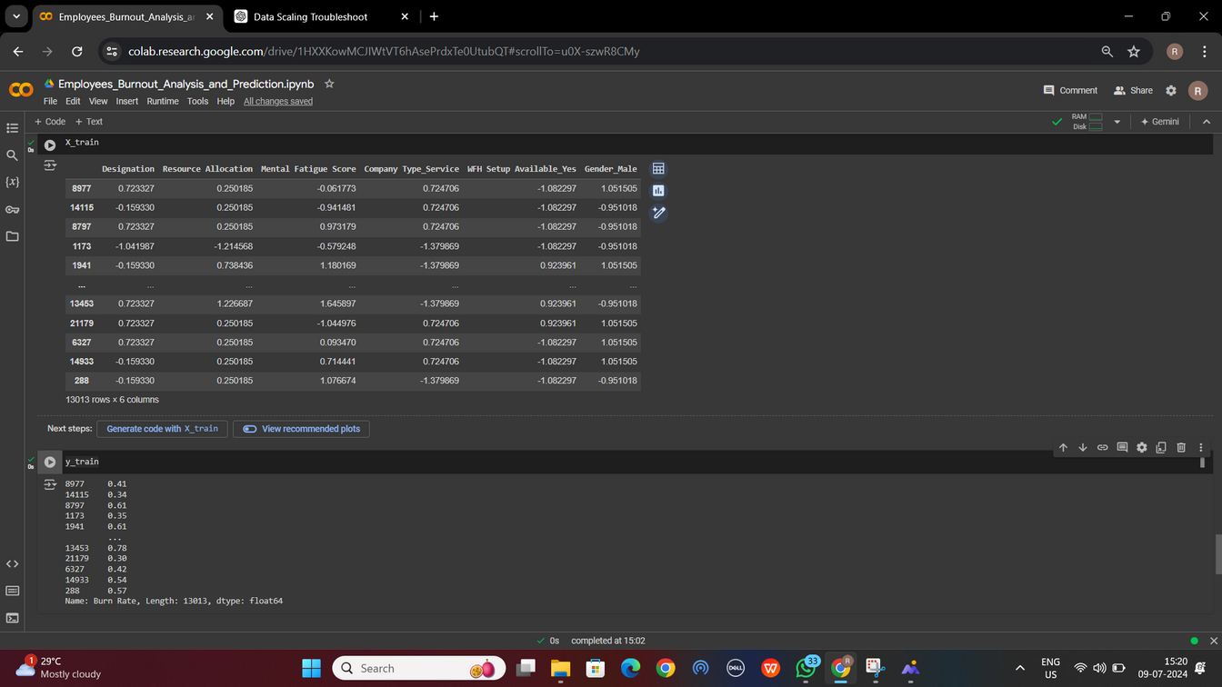
Results
The Decision Tree Regression model successfully predicted employee burnout rates with high accuracy. The evaluation metrics showed a strong fit, with the model effectively capturing the underlying patterns in the data.

Slide 10

links
https://github.com/SarvasuddiAjaykumar/Apssdc-AIML-project1/blob/main/Employee_Burnout_Analysis_and_Prediction.ipynb

